Slide 1
Fire Safety Deficiency Prediction

Slide 2
Clustering Fire Safety Deficiency Zone
Based on severity fire safety can be action can be taken

Slide 3
Data Acquisition and cleaning
Data was collected from https://healthdata.gov/dataset/fire-safety-deficiencies
Cleaned data

Slide 4
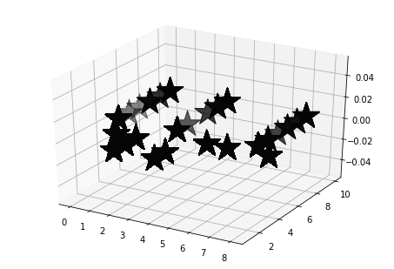
Clustering
Applied K-Means to cluster the zone

Slide 5
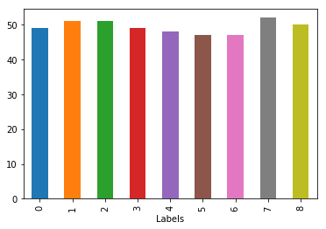
Graph based on states

Slide 6
Finding the probability
Used Logistic regression to predict and get the probability.
Probability of this prediction was
array([[9.99958355e-01, 4.16454238e-05], [9.99958355e-01, 4.16454238e-05], [9.99958355e-01, 4.16454238e-05], ..., [9.69241688e-01, 3.07583116e-02], [9.69241688e-01, 3.07583116e-02], [9.69241688e-01, 3.07583116e-02]])

Slide 7
Maps
Used Folium and FourSquare for map.

